Slide 1
Dryer SAP Guide Contents
Section 1: Logging into SAP & general SAP info
Section 2: Staging procedures (MB1B)
Section 3: View Inventory (MMBE)

Slide 2
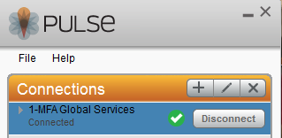

Section 1: Logging into SAP
1. Make sure you are logged into the MFA Global Services connection in Pulse
2. Double click on the SAP SSO Logon icon
3. Follow the prompts to log in just like you do for the MFA login

Slide 3
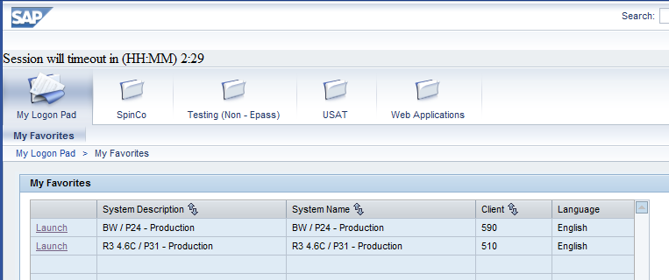
Note: SSO will keep you logged in for 12 hrs unless you exit. The timer shows you how long you have left on your login. If SAP times out, you can go back into this screen and click on the shortcut and it will log you back in to SAP.
Click on the shortcut “Launch” (Next to the “R3 4.6C / P31” Line). SAP should open automatically from here.

Slide 4
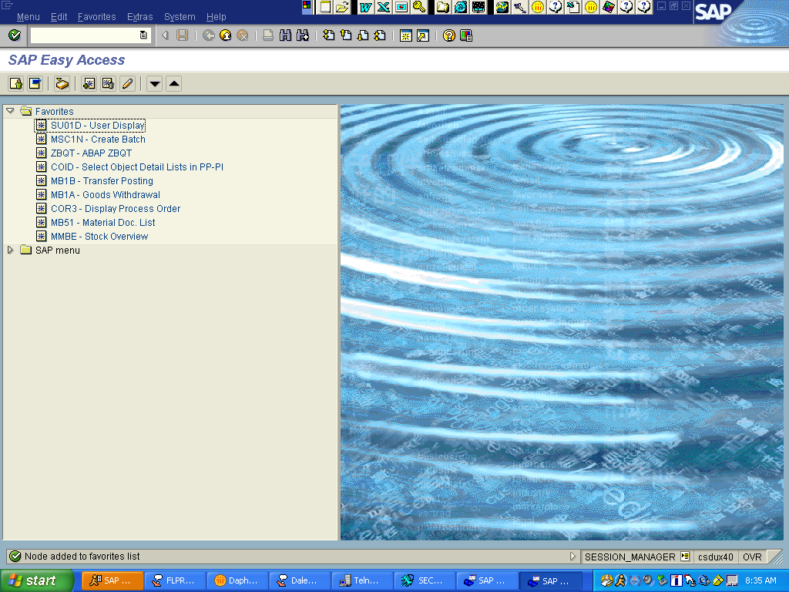
SAP Easy Access Main Menu

Slide 5
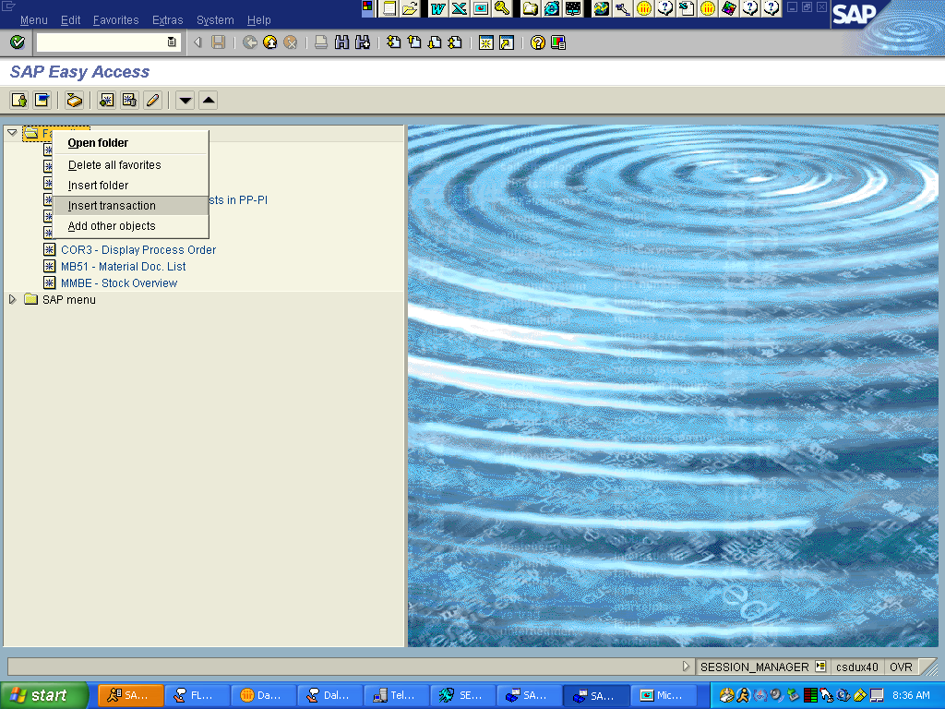
To add a Favorite: right click on the Favorites folder, choose Insert Transaction.

Slide 6
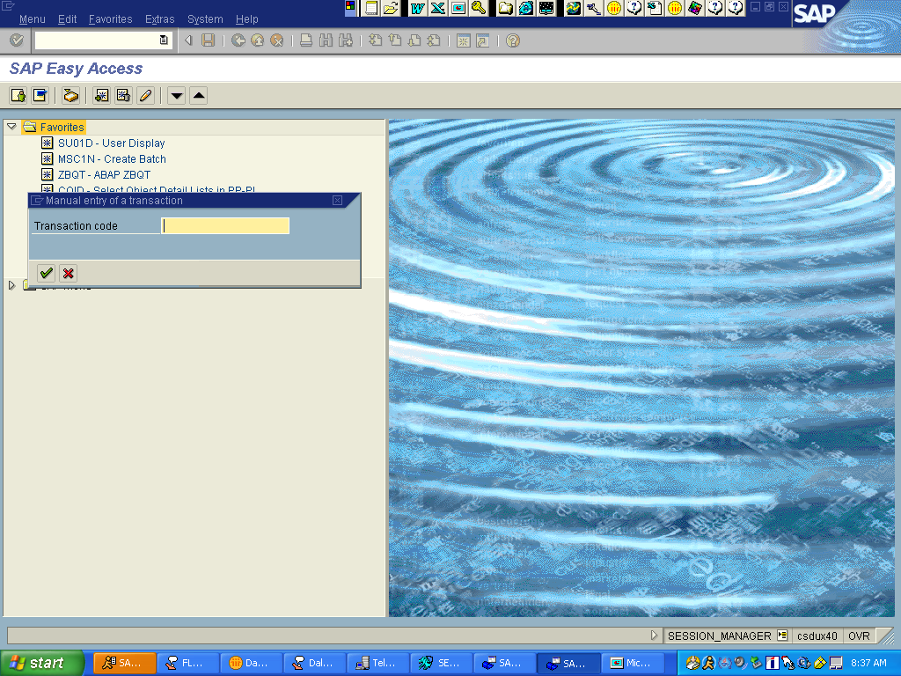
Type in new favorite transaction, for example MMBE, click the green checkmark, or hit Enter.

Slide 7
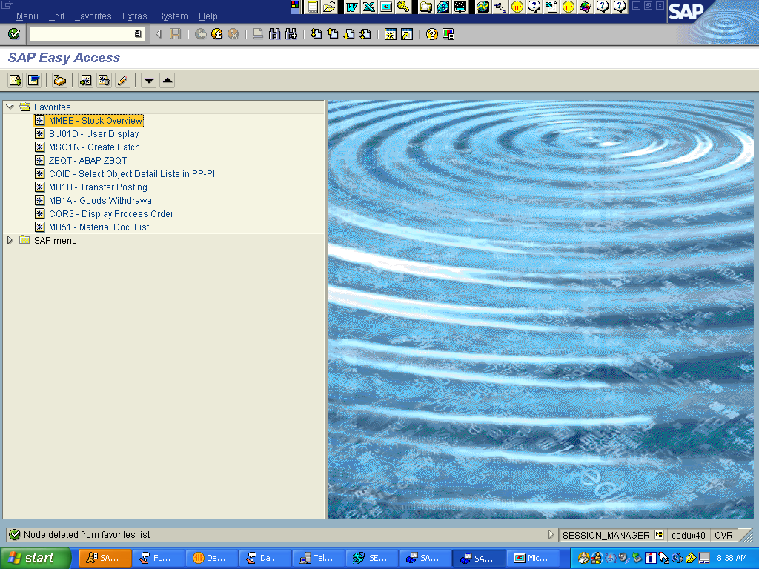
Verify new transaction was added to favorite folder.

Slide 8
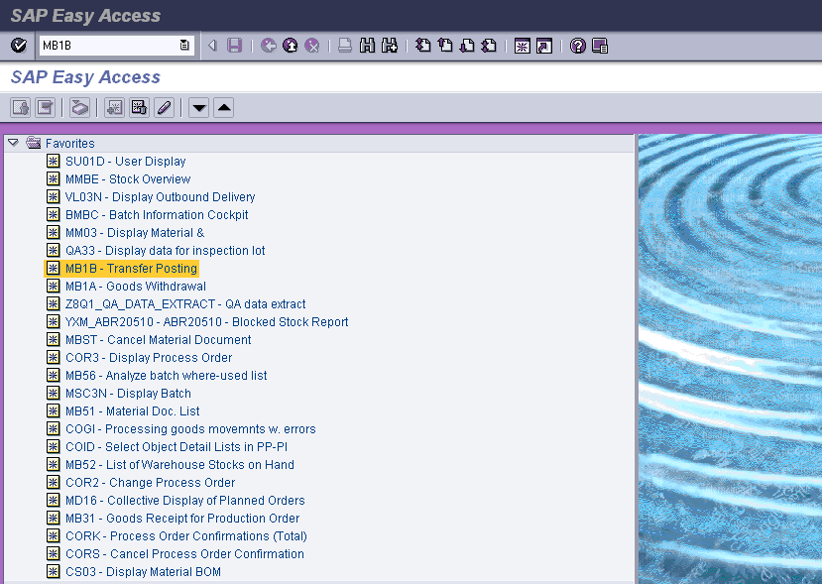
Section 2: Staging Raw Materials
Transaction: MB1B
When a raw material is staged for use into our process, we have to make a transaction in SAP.
This will move the raw material from the FPD0 storage area and add it to the FPD1 location for consumption.
The following material must be ‘staged’:
Ammonium Carbonate (D11661972)
From The SAP Easy Access
screen, enter MB1B in the command
field and hit Enter or click on
transaction under favorites folder.

Slide 9
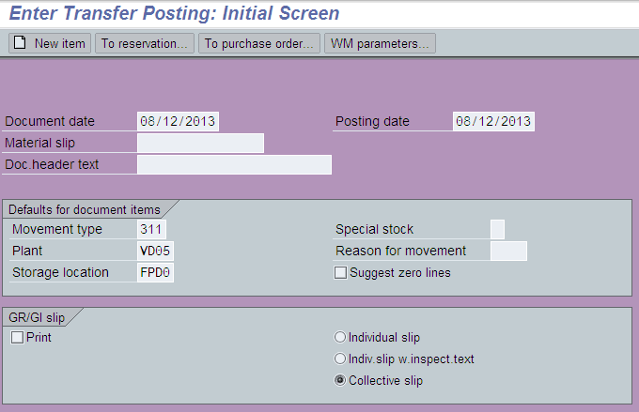
The following screen is displayed:
Enter Movement type - 311
Enter Plant code - VD05
Enter the Storage Location - FPD0 (zero)
Press Enter

Slide 10
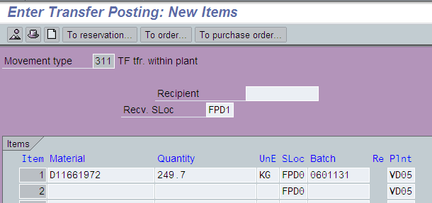
The following screen is displayed:
Enter the Recv. SLoc – FPD1
Enter Material – D11661972
Enter Quantity – (Enter the amount of kgs or the number of totes and EA for UnE)
Enter the Batch number (from tag on tote)
Press Enter

Slide 11
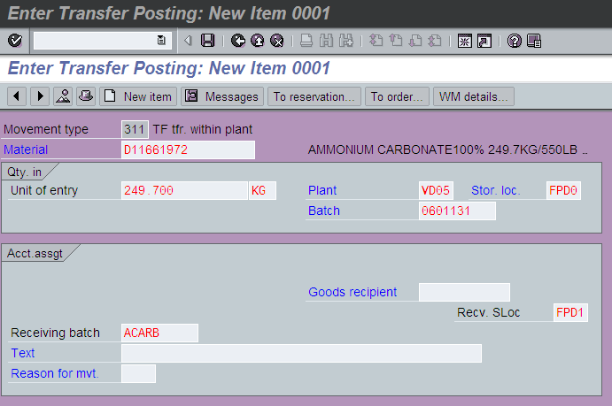
Changing The Batch Name
Change the receiving batch to ACARB (You will need to hit Enter through some warning messages. Keep hitting Enter until it takes you back to the overview screen.)
Click Save

Slide 12
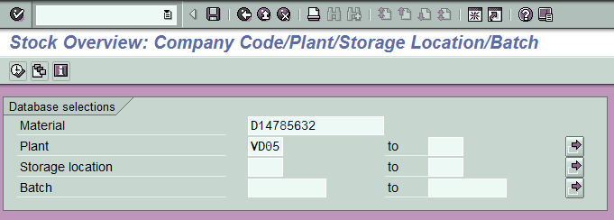
Section 3: View Inventory
Transaction: MMBE
Enter D code
Enter Plant code - VD05
Press Execute
Note: Not entering a storage location on this screen will show you all the inventory that is available in all areas at VD05. If you want to know a specific location, enter that Storage location on this screen (FPD0, FPD1, RM01, etc)

Slide 13
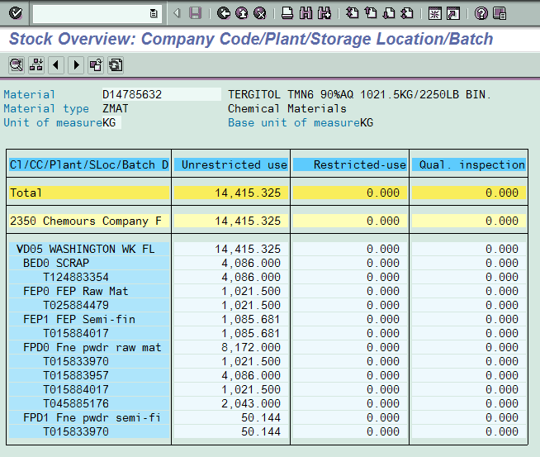
The following screen is displayed:
This screen shows all inventory in all locations or in a specific location if that location was entered on the previous screen.

